Slide 1
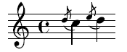
Grace: Safe Multithreaded Programming for C/C++ [OOPSLA 2009]
Emery Berger, Ting Yang, Tongping Liu, Gene Novark
University of Massachusetts, Amherst
www.cs.umass.edu/~emery

Slide 2
Garbage Collection

Slide 3

Garbage Collection

Slide 4
Garbage Collection
Idea: robot takes care of your garbage

Slide 5
Garbage Collection
Idea: runtime takes care of your memory errors

Slide 6
Garbage Collection
Result: success story!

Slide 7
Garbage Collection
Result: success story! (after ~35 years)

Slide 8

“Garbage Collection for Concurrency”

Slide 9
“Garbage Collection for Concurrency”
Goal: You write concurrent programs

Slide 10
“Garbage Collection for Concurrency”
Goal: You write concurrent programs
with as many bugs as you want!

Slide 11
“Garbage Collection for Concurrency”
Goal: You write concurrent programs
with as many bugs as you want!
Wall-E cleans up after you

Slide 12
“Garbage Collection for Concurrency”
How do I “garbage collect” concurrency errors?

Slide 14
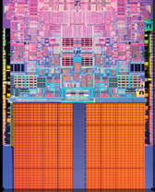

Slide 26
color = ; row = 0; // globals
void nextStripe(){
for (c = 0; c < Width; c++) {
drawBox (c,row,color);
}
color = (color == )?  : ; row++;
}
for (n = 0; n < 9; n++) {
nextStripe();
}

Slide 28


Slide 29


Slide 35
color = ; row = 0; // globals
void nextStripe(){
for (c = 0; c < Width; c++) {
drawBox (c,row,color);
}
color = (color == )?  : ; row++;
}
for (n = 0; n < 9; n++) {
spawn nextStripe();
}
sync;

Slide 36

“
”

Slide 42
race condition

Slide 43
color = ; row = 0; // globals
void nextStripe(){
for (c = 0; c < Width; c++) {
drawBox (c,row,color);
}
color = (color == )?  : ; row++;
}
for (n = 0; n < 9; n++) {
spawn nextStripe();
}
sync;

Slide 44
color = ; row = 0; // globals
void nextStripe(){
for (c = 0; c < Width; c++) {
drawBox (c,row,color);
}
color = (color == )?  : ; row++;
}
for (n = 0; n < 9; n++) {
spawn nextStripe();
}
sync;

Slide 45
color = ; row = 0; // globals
void nextStripe(){
for (c = 0; c < Width; c++) {
lock(); drawBox (c,row,color); unlock();
}
lock();
color = (color == )?  : ; row++;
unlock();
}
for (n = 0; n < 9; n++) {
spawn nextStripe();
}
sync;

Slide 50
atomicity violation

Slide 51
color = ; row = 0; // globals
void nextStripe(){
for (c = 0; c < Width; c++) {
lock(); drawBox (c,row,color); unlock();
}
lock();
color = (color == )?  : ; row++;
unlock();
}
for (n = 0; n < 9; n++) {
spawn nextStripe();
}
sync;

Slide 52
color = ; row = 0; // globals
void nextStripe(){
lock();
for (c = 0; c < Width; c++) {
drawBox (c,row,color);
}
color = (color == )?  : ; row++;
unlock();
}
for (n = 0; n < 9; n++) {
spawn nextStripe();
}
sync;

Slide 55
deadlock

Slide 59
order violation

Slide 61
sequential

Slide 62

sequential

Slide 64
race conditions

Slide 65
race conditions
atomicity violations

Slide 66
race conditions
atomicity violations
deadlock

Slide 67
race conditions
atomicity violations
deadlock
order violations

Slide 68


Slide 69
race conditions
atomicity violations
Grace
deadlock
order violations

Slide 70
race conditions
atomicity violations
Grace
deadlock
order violations

Slide 71
race conditions
atomicity violations
Grace
deadlock
order violations
sequential

Slide 72
Grace
% g++ myprog.cpp –lpthread –o myprog

Slide 73
Grace
% g++ myprog.cpp –lgrace –o myprog

Slide 74
Grace
% g++ myprog.cpp –lgrace –o myprog
sequential

Slide 75
Grace
% g++ myprog.cpp –lgrace –o myprog
sequential
race conditions
atomicity violations
deadlock
order violations

Slide 76
Grace
% g++ myprog.cpp –lgrace –o myprog
sequential
race conditions
atomicity violations
deadlock
order violations

Slide 77
Grace
1.
sequential
+
?

Slide 78
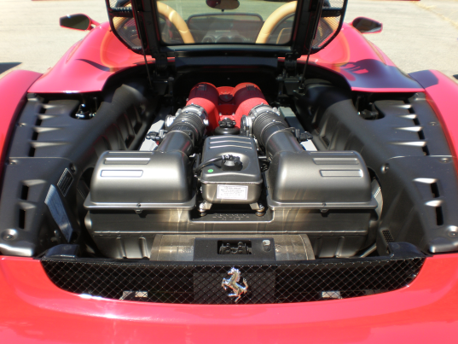
Grace
1.
sequential
+
?
2.

Slide 79
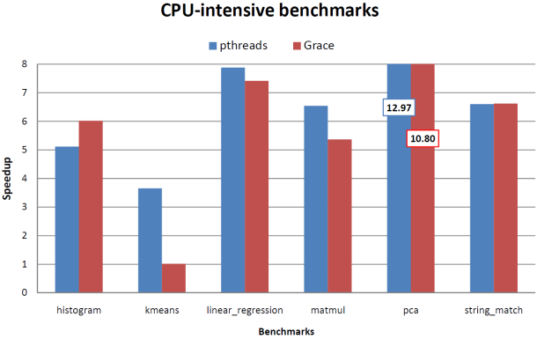
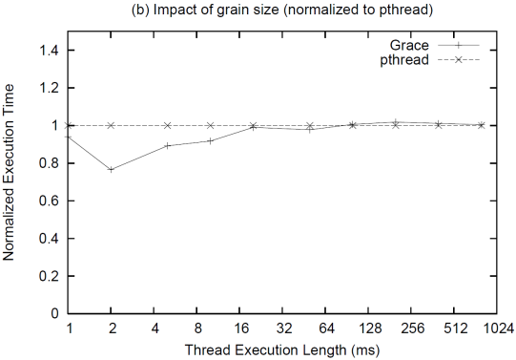
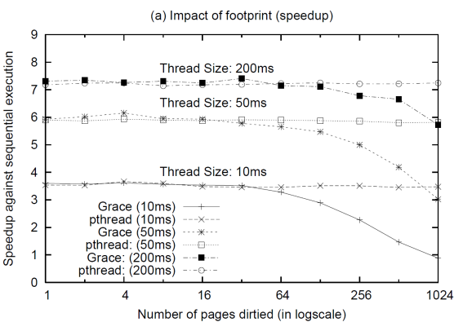
Grace
1.
sequential
+
?
2.
3.

Slide 80
1.
sequential
+
?

Slide 81
1.
sequential
+
?
t1 = spawn f(x);
t2 = spawn g(y);
sync;

Slide 82
1.
sequential
+
?
spawn f(x)
t1 = spawn f(x);
t2 = spawn g(y);
sync;

Slide 83

1.
sequential
+
?
spawn f(x)
t1 = spawn f(x);
t2 = spawn g(y);
sync;
f(x)

Slide 84
1.
sequential
+
?
spawn f(x)
t1 = spawn f(x);
t2 = spawn g(y);
sync;
f(x)
spawn g(y)

Slide 85
1.
sequential
+
?
spawn f(x)
t1 = spawn f(x);
t2 = spawn g(y);
sync;
f(x)
spawn g(y)
g(y)

Slide 86
1.
sequential
+
?
spawn f(x)
t1 = spawn f(x);
t2 = spawn g(y);
sync;
f(x)
spawn g(y)
g(y)
sync

Slide 87
1.
sequential
+
?
spawn f(x)
t1 = spawn f(x);
t2 = spawn g(y);
sync;
f(x)
spawn g(y)
g(y)
sync

Slide 88
1.
sequential
+
?
spawn f(x)
t1 = spawn f(x);
t2 = spawn g(y);
sync;
f(x)
spawn g(y)
g(y)
left-to-right, depth-first ordering
sync

Slide 89
1.
sequential
+
?
f(x)
t1 = spawn f(x);
t2 = spawn g(y);
sync;
g(y)

Slide 90
1.
sequential
+
?
“
f(x)
”
t1 = spawn f(x);
t2 = spawn g(y);
sync;
g(y)

Slide 91
1.
sequential
+
?
“
f(x)
”
g(y)

Slide 92
1.
sequential
+
?
“
f(x)
”
race conditions
g(y)
atomicity violations
deadlock
order violations

Slide 93
1.
sequential
+
?
“
f(x)
”
race conditions
g(y)
atomicity violations
deadlock
order violations

Slide 94
1.
sequential
+
?
“
f(x)
”
race conditions
g(y)
atomicity violations
deadlock
order violations

Slide 95

1.
sequential
+
?
“
f(x)
”
race conditions
g(y)
atomicity violations
deadlock
order violations

Slide 96
1.
sequential
+
?
“
f(x)
”
race conditions
g(y)
atomicity violations
deadlock
order violations

Slide 97
1.
sequential
+
?
“
f(x)
”
race conditions
g(y)
atomicity violations
deadlock
order violations

Slide 98
1.
sequential
+
?
“
f(x)
”
race conditions
g(y)
atomicity violations
deadlock
order violations

Slide 99

1.
sequential
+
?
“
f(x)
”
g(y)

Slide 100
1.
sequential
+
?
“
f(x)
”
g(y)

Slide 101

1.
sequential
+
?
“
f(x)
”
g(y)

Slide 102
1.
sequential
+
?
“
f(x)
”
g(y)

Slide 103
1.
sequential
+
?
“
f(x)
”
g(y)

Slide 104

1.
sequential
+
?
“
f(x)
”
g(y)
Fork-join (e.g., map-reduce, Cilk, TBB…)

Slide 105
2.
?
What’s under the hood?

Slide 106

2.
?
“Magic!”

Slide 107

2.
?
+

Slide 108
2.
?

Slide 109

2.
?
t1 = spawn f(x);
t2 = spawn g(y);
sync;

Slide 110

2.
?
t1 = spawn f(x);
t2 = spawn g(y);
sync;
if (!fork())
f(x);
if (!fork())
g(y);
// check;

Slide 111
spawn f(x)
2.
?
f(x)
spawn g(y)
g(y)
sync
if (!fork())
f(x);
if (!fork())
g(y);
// check;

Slide 112

spawn f(x)
2.
?
f(x)
spawn g(y)
g(y)
sync
if (!fork())
f(x);
if (!fork())
g(y);
// check;

Slide 113
spawn f(x)
2.
?
f(x)
spawn g(y)
g(y)
sync
Note: Nested threads ok
if (!fork())
f(x);
if (!fork())
g(y);
// check;

Slide 114
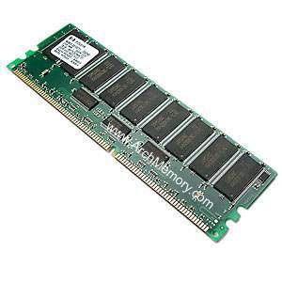
spawn f(x)
2.
?
f(x)
spawn g(y)
g(y)
mmap
sync

Slide 115
spawn f(x)
2.
?
f(x)
spawn g(y)
g(y)
mmap
sync

Slide 116
spawn f(x)
2.
?
f(x)
spawn g(y)
g(y)
mmap
sync

Slide 117
spawn f(x)
2.
?
f(x)
spawn g(y)
g(y)
sync

Slide 118
spawn f(x)
2.
?
f(x)
spawn g(y)
g(y)
sync
1

Slide 119
spawn f(x)
2.
?
f(x)
spawn g(y)
g(y)
sync
1
2

Slide 120


2.
?
scalable heap + aligned globals I/O (buffering + ordering)

Slide 121
3.

Slide 123
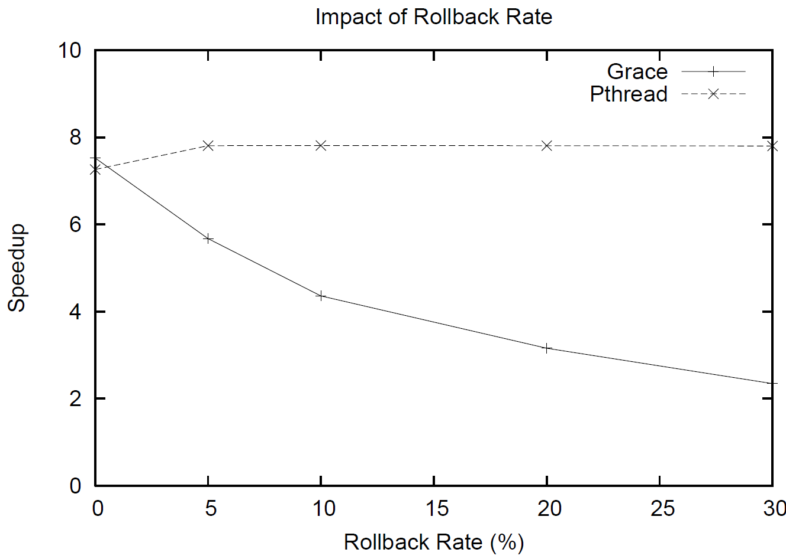

Slide 124



Slide 125
Safe and (usually) fast*
*1—16 lines changed

Slide 126
Safe and (usually) fast…
benign race

Slide 127

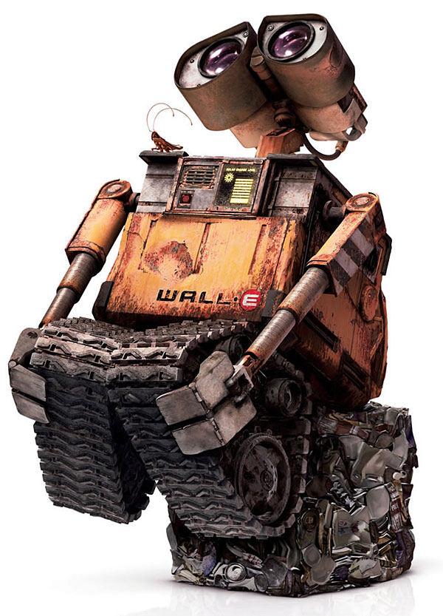
Grace
sequential
race conditions
atomicity violations
deadlock
order violations
% g++ myprog.cpp –lgrace –o myprog

Slide 128


“Moltes gràcies”

